Slide 1
Employee Data Analysis using Excel
STUDENT NAME:KAMESH B
REGISTER NO:312207295
NAAN MUDHALVAN ID :66491DEE02713DEBB1849D10728F2C8C
DEPARTMENT:B.COM (GENERAL)
COLLEGE: C KANDASWAMI NAIDU COLLEGE FOR MEN

Slide 2
PROJECT TITLE
Work Location Analysis using Excel Modeling

Slide 3


AGENDA
Problem Statement
Project Overview
End Users
Our Solution and Proposition
Dataset Description
Modelling Approach
Results and Discussion
Conclusion
3/21/2024 Annual Review

Slide 4

PROBLEM STATEMENT
The charts display the distribution of employees across various work locations. The bar chart shows the absolute count of employees at each location, with the highest number being remote (44), followed by Hyderabad, India (33). The pie chart represents the same data in percentages, highlighting that 24% of the workforce is remote, with other locations like Hyderabad, Columbus, and Chennai having smaller but significant shares. The key insight is that remote work is the most common work location, followed by Hyderabad.

Slide 5

PROJECT OVERVIEW
This project will analyzing and evaluating employees performance across various departments such as Human resources, marketing, Acconting, services, research and development, Legal, Support, Engineering.This project includes graphs and pie chart and this project will result in a comprehensive, user-friendly excel tool that can be regularly updated and used by HR and management to drive performance improvemets within the organistion.
.

Slide 6

WHO ARE THE END USERS?
Employees:
Individual Employees May have access to their performance data and metrics to self-assess and identify areas for personal improvement.
Business Organization:
Business Organization and Analysts Use the data to support performance reviews, identify training needs, and develop employee development plans.Recruitment Teams Analyze data to understand the skills and performance trends that are beneficial for hiring.

Slide 7

OUR SOLUTION AND ITS VALUE PROPOSITION
Solution Summary:
Current Assessment:Analyze the existing workforce distribution, focusing on remote work and key locations like Hyderabad and Chennai, while evaluating associated costs.
Predictive Planning: Use models to forecast future workforce needs and create scenarios to plan for growth or changes.
Optimization: Apply strategies to allocate resources efficiently across locations, and develop a flexible remote work policy to balance cost, productivity, and employee satisfaction.
Workforce Segmentation: Group employees by location and preferences to tailor management and engagement strategies.
Implementation: Roll out the strategy in phases, monitor its effectiveness with KPIs, and make adjustments as needed.
Value Proposition:
Cost Efficiency: Reduce office-related costs.
Employee Satisfaction: Improve morale with a flexible remote work policy.
Strategic Growth: Enable informed expansion or adjustments.
Resilience: Increase adaptability to changing conditions.
This approach provides a balanced, efficient strategy for managing a global workforce.

Slide 8
Dataset Description
The dataset for employee performance analysis typically includes various metrics that reflect
an employee's productivity, quality of work, attendance, and overall contribution to the
organization. Below is a description of the key columns that would be included in a Actionable Insights which Include recommendations or action items based on the analysis, such as training needs or performance improvement plans.
Excel dataset:
EmpID: A unique identifier for each employee.
Employee Name: The employee’s given name.
Gender Code: A code representing the gender of the employee (e.g., M for Male, F for Female, etc.)
Business Unit: The department or division within the company where the employee works.
Employee Salary: The amount of salary that the empoyee gets for their work.
Employee Type: Classification of the employee, such as full-time, part-time, contractor, etc.
Employee location: Location of the employee where he works.

Slide 9

THE "WOW" IN OUR SOLUTION
wow" features combine to create a powerful,
efficient, and intuitive Excel-based solution that
not only meets but exceeds expectations in
managing and analyzing employee
Performance. The solution includes an AI-driven feature that suggests actionable improvements based on performance trends, helping managers to implement effective strategies for boosting productivity and employee engagement. To improvement. This holistic view promotes better strategic decision-making.
3/21/2024 Annual Review

Slide 10
MODELLING
Predictive Modeling: Forecast future employee distribution across locations using time series analysis or regression models.
Optimization: Use linear or integer programming to optimize workforce allocation across different locations to minimize costs or maximize efficiency.
Clustering: Group employees based on work location or mode (remote vs. on-site) using clustering techniques like K-means
.
Classification: Predict whether an employee is more likely to work remotely or at a specific location using logistic regression or decision trees.
Scenario Analysis: Simulate different scenarios to see how changes in external factors might affect workforce distribution.

Slide 11
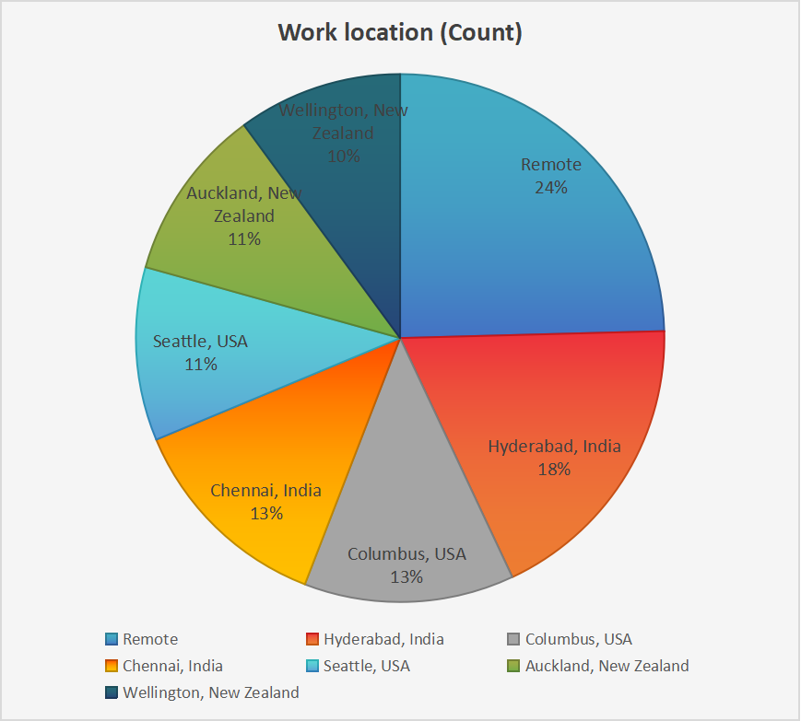
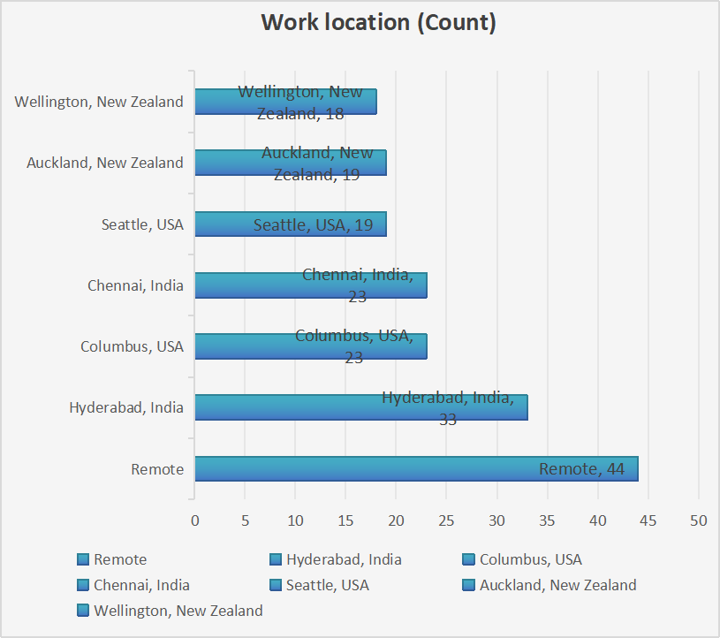
RESULTS
Bar Chart (Work Location Count)
Remote work has the highest number of employees, with 44 people, indicating a strong preference or necessity for remote work in your organization.
Hyderabad, India follows with 33 employees, making it the most populated physical location.
Chennai, India and Columbus, USA both have 23 employees each, showing these are also significant hubs for your workforce.
Seattle, USA and Auckland, New Zealand each have 19 employees, representing smaller but still notable work centers.
Wellington, New Zealand has the smallest count with 18 employees.
Pie Chart (Work Location Percentage)
Remote work constitutes 24% of the total workforce, which is the largest share among all locations.
Hyderabad, India accounts for 18%, making it the second-largest location by percentage.
Chennai, India and Columbus, USA each contribute 13% to the workforce, showing equal distribution between these two locations.
Seattle, USA and Auckland, New Zealand both represent 11%, while Wellington, New Zealand represents 10%, indicating a relatively even distribution among these locations.

Slide 12
conclusion
This Excel-based approach provides a scalable, adaptable, and efficient method for enhancing employee performance management.By leveraging data analytics, the organization can foster a culture of continuous improvement and drive overall success.Implemented an Excel-based solution for systematic employee performance analysis.Addressed the lack of consistency in evaluating performance, leading to more informed decision-making.Enabled identification of top performers, areas needing support, and overall productivity trends.Enhanced data-driven insights for management and HR.Streamlined reporting processes and reduced manual effort.Improved employee engagement and targeted development strategies.Regular updates and refinements to the model based on feedback.Integration with other data sources for a more holistic view.Continuous training for end-users to maximize tool effectiveness.

